Slide 1

Phishing Detection, Chess Cognition, and the Future of SOC Analyst Training
Ioana Macovei
Research affiliated with University of Sunderland
Upcoming Munster Technological University PhD Student

Slide 2
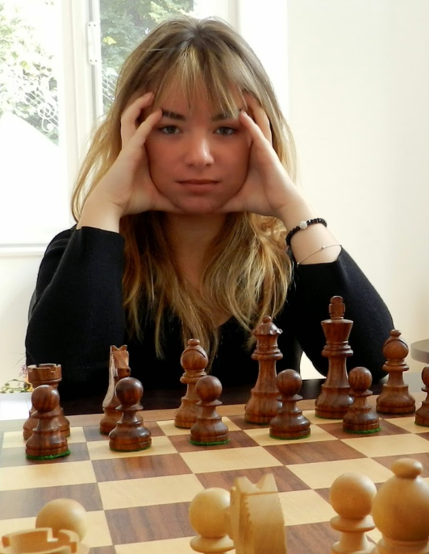
About me…
-the professional side-
-the chess side-
Former Fraud Researcher
Cybersecurity Researcher at MTU
BA Psychology
BSc IT Management
PgDip Cybersecurity
Upcoming PhD Student
Chess FIDE Master
Former European Junior Champion
10th in the World at the WJCC 2015
3x Irish Women’s Champion
Former Irish Women’s Olympic Team Captain
Irish National Junior Squad Coach
Former Romanian Junior Champion (multiple)
Limerick Open Winner
City Of Dublin Masters Open Runner-Up

Slide 3

The Problem
Phishing is still dominant
2024 Microsoft Digital Defense Report: 107 word mentions
Technology helps but…
The human layer is still the weakest link

Slide 4

How THIS *ONGOING* research started…
Original research opportunity!
Chess trains how we switch between fast intuition and slow analysis
This exact cognitive tension is exploited by phishing attacks!
Would chess players be better at spotting phishing emails?
Notes:
“As part of my postgraduate diploma, I was offered the opportunity to do original research. I’ve played competitive chess for years, and I knew that chess trains how we switch between fast intuition and slow analysis ,the exact cognitive tension phishing attacks try to exploit.
So I thought: what if chess players are naturally better at spotting phishing emails?”

Slide 5

Cognitive Psychology & Chess
Two seminal works
A de Groot – Thought and Choice in Chess (1965)
Masters didn’t look further ahead than amateurs in number of moves.
Instead, they had better pattern recognition, leading to faster, more accurate decisions.
Introduced the idea that expertise relies on chunking, storing meaningful patterns in memory.
Chase and Simon – Perception in Chess (1973) used memory recall experiments with chess positions that showed:
Masters could recall real (structured) chess positions almost perfectly. But they performed no better than novices with random positions.
This confirmed that expertise comes from recognizing meaningful chunks, not general memory ability.
Notes:
There are many theories that try to explain how we think. Some are very out there while some are very easy to grasp. Surprisingly to me at first, there are also a ton of theories that researched why and how chess players get so good at chess. Personally, I always believed That chess is a skill you learn by practice, practice, practice. I was not one of the few lucky people just born with a gift are what we call “talented”, and they become grand masters by age 13. I studied chess as a job since the age of 8, Thats how I got good. I was not talented I just worked a lot. Going bck to research, researchers looked into how then chess players get to master the game. So they obviously looked at what happens in their mind. Two seminal works are A de Groot’s who found: Masters didn’t look further ahead than amateurs in number of moves. Instead, they had better pattern recognition, leading to faster, more accurate decisions. Introduced the idea that expertise relies on chunking — storing meaningful patterns in memory. Chase and Simon used memory recall experiments with chess positions that showed: Masters could recall real (structured) chess positions almost perfectly.But they performed no better than novices with random positions. This confirmed that expertise comes from recognizing meaningful chunks, not general memory ability.

Slide 6
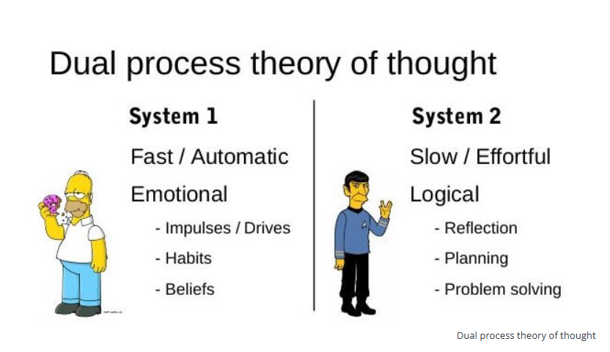
Dual Process Theory
Credit: structural-learning.com
As initially studied by Evans and Stankovich (2013)

Slide 7
Dual Process Theory
Chess
System 1
“That pawn move looks familiar, probably a Queen’s Gambit”.
System 2
“Wait… if I accept the gambit, I lose tempo and weaken my King side. Better decline it.”
Phishing detection
System 1
“It’s an Amazon email, I’ve seen this a million times. Must be safe”.
System 2
“Hm, the email asks me to reset a password, but the address is suspicious…”

Slide 8
Dual Process Theory
Cognitive Decoupling
Chess players are trained to flip between these systems constantly (“c.d.”).
Modern anti-phishing training revolves around training the analytical thinking system.
In phishing, attackers exploit your fast, instinctive System 1.
Benefits to training both systems and the switching between them?
Notes:
In both chess and phishing, decisions made too quickly can be dangerous, switching systems is a cognitive skill.

Slide 9
Dual Process Theory
Phishing Emails
Phishing emails are designed to manipulate Cognitive Biases or Type 1 Thinking faults and weaknesses, such as emotions:
curiosity
fear
excitement
pity
urgency (David & Bode-Asa, 2023)

Slide 10
Dual Process Theory
Phishing Emails
Psychological attack vectors:
consistency
urgency
scarcity
liking
social proof
authority
Reciprocity (Gallo et. al., 2024)

Slide 11
Dual Process Theory
Phishing Emails
Cue Utilization
Implicit Cues:
lack of personalization
sense of urgency
Explicit Cues:
security warnings prompted by an email tool (Baltuttis & Teubner, 2024)

Slide 12
Dual Process Theory
Phishing Emails
Cue Utilization
Intuition-based decision-making process (Type 1 thinking) has been linked to greater phishing susceptibility
Tendency towards a less intuitive
way of thinking (Type 2) reduces phishing susceptibility (Sturman et. Al., 2025)
…are we missing something?
Notes:
"If phishing attacks exploit Type 1 thinking, yet our training focuses almost entirely on promoting Type 2 thinking… are we missing something?

Slide 13
Dual Process Theory
Chess
Cue Utilization
Orientation Phase
Chess players rely on specific cues
(like piece tensions, open lines, threats) to orient themselves
This activates pattern recognition in chess players
What follows?
Proof Phase
Chess players analytically verify their pattern-based intuition (De Groot, 1965)

Slide 14
Dual Process Theory
?
Cue Utilization
What other cybersecurity professionals engage both systems under pressure…
Quick pattern recognition
Deliberate analysis
To discuss later…

Slide 15
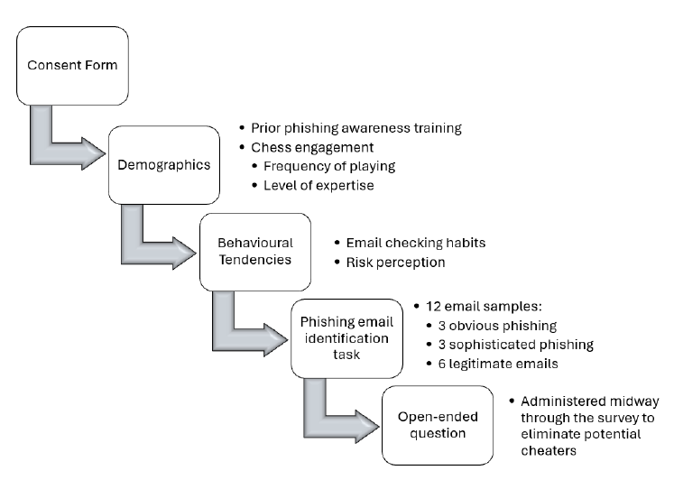
Research Methodology
Microsoft Forms Survey
2 weeks open, early 2025
61 participants (33 chess/ 28 non-chess)
14 questions, followed by 12 phishing emails

Slide 16

Obvious Phishing Email example
Notes:
90% of participants found this correctly

Slide 17

Sophisticated Phishing Email example
Notes:
81.97% got this WRONG

Slide 18

Legitimate Email example
Notes:
85.25% people got this WRONG

Slide 19
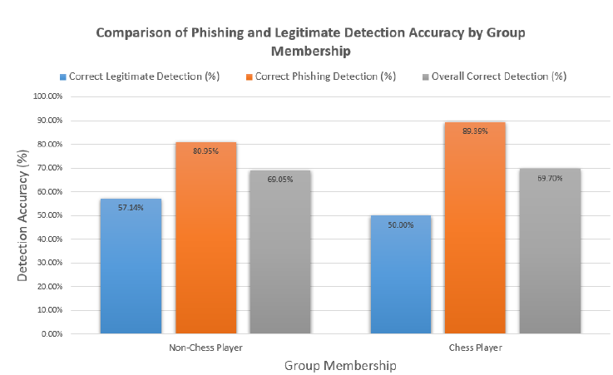
Key Results
Chess players significantly outperform non-chess players in phishing detection
Notes:
In general, cyber training did not appear to have a strong impact on accuracy

Slide 20
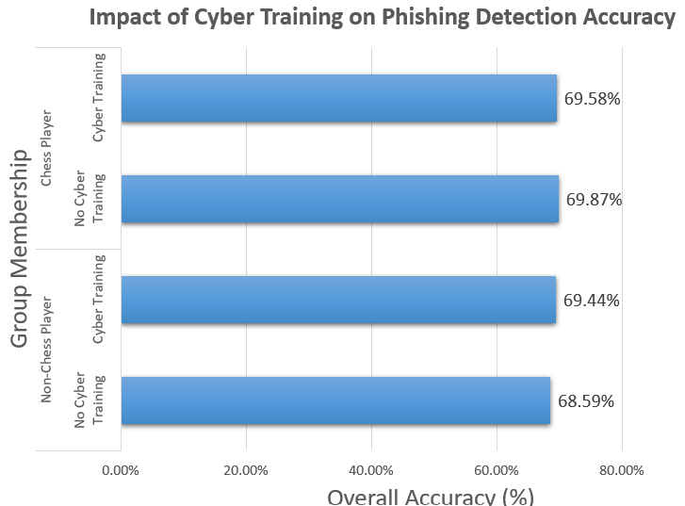
Cybersecurity training ≠ better phishing detection
Cyber training did not reach significance
In general, the cyber training program does not have a strong impact on accuracy
Notes:
35 YES
26 NO

Slide 21
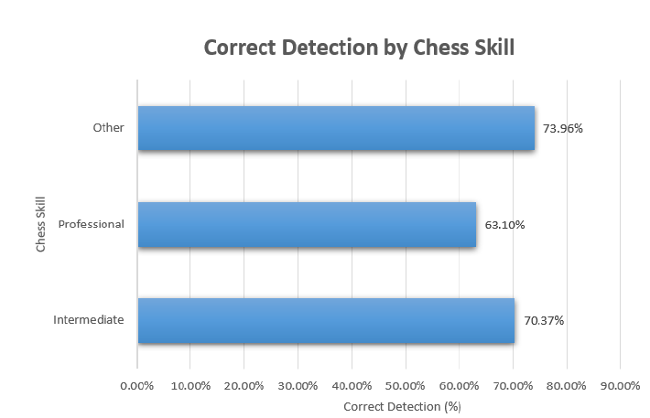
Key Results
Within-group analysis found that beginner/ amateur and intermediate chess players outperformed chess professionals!

Slide 22
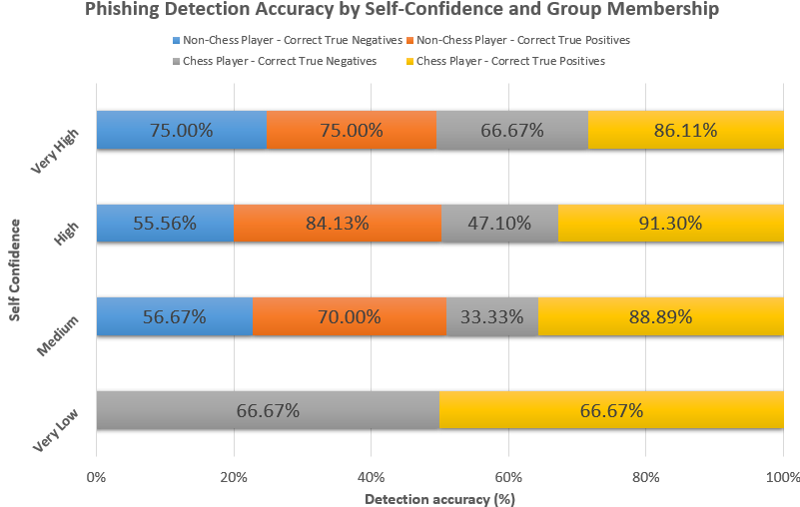
Key Results
Higher self-confidence may influence a participant’s
phishing detection style, potentially leading to greater vigilance at the cost of false positives (no statistical significance observed)
Further reading: Canfield, Fischhoff and Davis did significantly find
that participants were consistently overconfident for phishing
emails

Slide 23
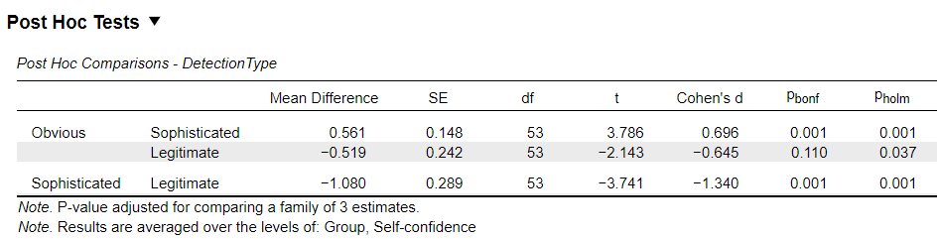
Key Results
Detection accuracy was significantly higher for obvious phishing compared to sophisticated phishing and for legitimate emails compared to sophisticated phishing
Notes:
A post hoc comparison using Bonferroni correction revealed that detection accuracy was significantly higher for obvious phishing compared to sophisticated phishing (p = .001, d = 0.696), and for legitimate emails compared to sophisticated phishing (p = .001, d = 1.34). The difference between obvious phishing and legitimate emails was marginally significant under Holm correction (p = .037), but not under Bonferroni (p = .110).
This shows that the participants, even confident ones, still struggled with sophisticated phishing emails, which are designed to evade System 2 scrutiny. This reinforces the need for continual cognitive training, alertness, and better phishing simulation tools.

Slide 24
Key Results
Chess players identified obvious & sophisticated better than legitimate
Non-chess players also better at both phishing types than legitimate
Notes:
Chess Players:
Identified obvious phishing significantly better than legitimate
Identified sophisticated phishing better than legitimate
Non-Chess Players:
Better at both phishing types than legitimate emails
Better at obvious vs sophisticated phishing
Indicates drop in accuracy as phishing difficulty increased
Ironically, it wasn't the phishing emails that tripped participants up the most, it was the legitimate ones. Half of the time, they flagged real messages as phishing.

Slide 25
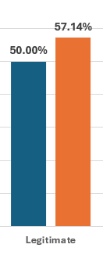
Key Results
Well, that’s worrying!
Over-cautiousness?
Bias towards suspecting deception?
Aligned with System 1 thinking – quick, emotional, risk-averse reaction
Notes:
Ironically, it wasn't the phishing emails that tripped participants up the most, it was the legitimate ones. Half of the time, they flagged real messages as phishing.

Slide 26

Interpretation
Participants were most vulnerable to sophisticated phishing attacks
Chess players’ training in pattern recognition and cognitive switching may be what helps bridge the gap
Chess players – more skeptical?

Slide 27
Interpretation
Modern anti-phishing training is focused on training System 2
It may benefit from enhancing individuals’ ability to fluidly switch between fast cue recognition and slow cue evaluation
Notes:
Consistent
with modern training’s emphasis on System 2 engagement, this
suggests that developing and training skills involved in both types
of thinking – intuitive and analytical – may be a feasible approach
to fighting the phishing epidemic. Furthermore, the study results
indicate that modern anti-phishing training may benefit from
enhancing individuals’ ability to fluidly switch between fast cue
recognition and slow cue evaluation, as chess players are trained
to do [5], which is in tune with these anti-phishing training
recommendations

Slide 28
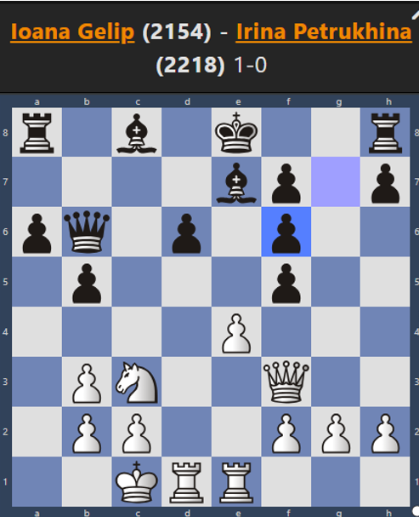
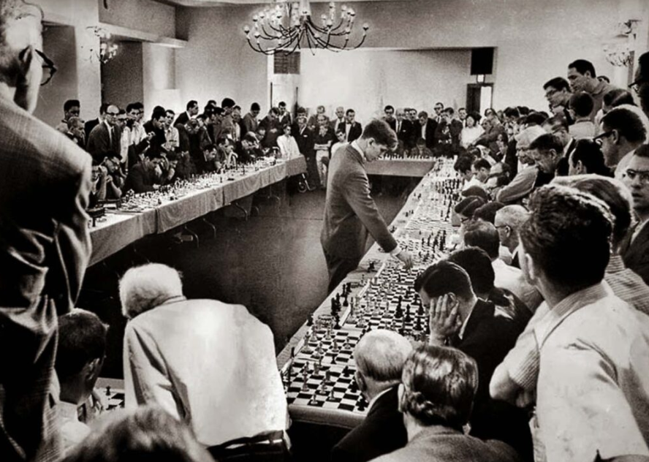
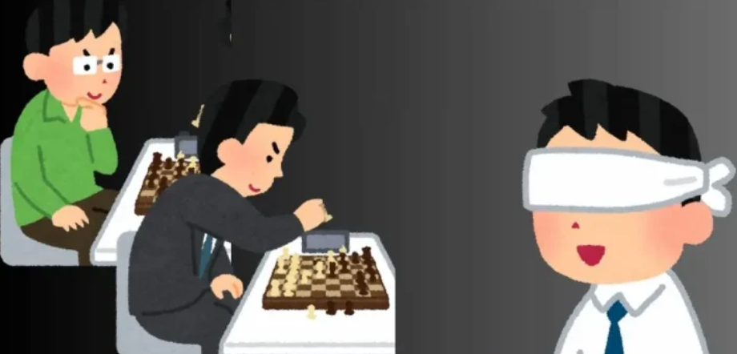
What exactly is Chess Training?
Chess Puzzles
Blindfold training
Simultaneous Exhibitions
Credit:chess-teacher.com
World Champion Bobby Fischer, playing a Simul against 50 opponents

Slide 29
Back to my question…
What other cybersecurity professionals engage both systems under pressure…
Quick pattern recognition
Deliberate analysis

Slide 30
Back to my question…
What other cybersecurity professionals engage both systems under pressure…
Their job is cognitively similar to solving multiple chess puzzles simultaneously
OR playing a very long, 8h game of chess a day, everyday, for the rest of their days!

Slide 31
The Answer
SOC analysts face similar cognitive pressure and information overload
Previous studies (Ahmed et al., 2022; Dykstra & Paul, 2018; Kearney et al., 2023, Mizrak et al., 2025) highlight cognitive fatigue as a core challenge in cybersecurity operations…
Although a substantial body of research exists on SOC operations technology and on human factors individually, there is a lack of studies that integrate these two dimensions.
Interesting read: “Tools Make Me Snore: A Next-Gen Framework for Training SOC Analysts Non-Perishable Skills”, Hahn et al., 2025

Slide 32
Dual Process Theory
Chess
System 1
“That pawn move looks familiar, probably a Queen’s Gambit”.
System 2
“Wait… if I accept the gambit, I lose tempo and weaken my King side. Better decline it.”
SOC Analysts
System 1
Glancing at an alert and instantly flagging it as benign or suspicious based on past experience.
System 2
Cross-checking indicators with threat intelligence feeds or writing correlation rules.

Slide 33
Future Work – upcoming PhD
Chess | MITRE ATT&CK
Forks | Techniques involving accessing multiple lateral targets
Pins | Ransomware T1486 that encrypts valuable data on a critical system, that immobilizes defenders
Sacrifices | Dropping malware that’s likely to be detected in order to mislead
Can the MITRE ATT&CK framework be successfully mapped to chess strategy and adversarial reasoning?
Notes:
Chess teaches us many useful strategic principles. But in cyber, we need to adapt them carefully , because the ‘opponent’ plays by different rules, and we’re not allowed to flip the board.

Slide 34
Future Work – upcoming PhD
Chess
The best defense is a counterattack
MITRE ATT&CK
Wait, that’s illegal!
Can the MITRE ATT&CK framework be successfully mapped to chess strategy and adversarial reasoning?
Not Always 1:1
Notes:
Chess teaches us many useful strategic principles. But in cyber, we need to adapt them carefully , because the ‘opponent’ plays by different rules, and we’re not allowed to flip the board.

Slide 35
Future Work – upcoming PhD
Chess
Sacrifice for initiative
MITRE ATT&CK
Leave a vulnerability exposed as “bait” (*Exception honeypots)
Can the MITRE ATT&CK framework be successfully mapped to chess strategy and adversarial reasoning?
Not Always 1:1
Notes:
Chess teaches us many useful strategic principles. But in cyber, we need to adapt them carefully , because the ‘opponent’ plays by different rules, and we’re not allowed to flip the board.

Slide 36
Future Work – upcoming PhD
Can we borrow cognitive training strategies from chess and use them for SOC Analysts?
Cognitive drills?
Chess-based scenarios?
Train SOCs to spot patterns better?

Slide 37
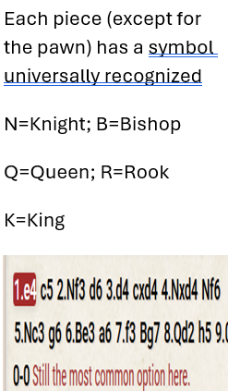
Future Work – upcoming PhD
What about chess-based notation in cyber incident recording?
Cognitive offloading, such as writing down tasks, can reduce memory load and support performance (Risko & Gilbert, 2016)

Slide 38
Future Work – upcoming PhD
Current SOC training addresses technology and the use of tools.
The proposed training framework addresses how domain knowledge and exam-type chess-based training models may:
enhance SOC analysts pattern recognition
promote learning of MITRE ATT&CK TTPs
easing SOC analyst’s fatigue

Slide 39

Implication for SOC/ AI
As AI takes over the false positives, analysts will be left with the more complex tasks
…therefore, their cognitive skills will matter even more
Are your SOC analysts left idle because of AI?
Notes:
If soc 1 is replaced by AI, how will you train your SOC2?

Slide 40
Takeaways
Phishing exploits fast thinking -> training should support both fast & slow systems
Chess players performed better in phishing detection
Chess players did tend be more skeptical…
Next step: research into adapting this for SOC analysts

Slide 41
Further reading
“Microsoft Digital Defense Report 2024.” [Online]. Available: https://www.microsoft.com/en-us/security/security-insider/intelligencereports/microsoft-digital-defense-report-2024
J. Evans and K. Stanovich, “Dual-Process Theories of Higher Cognition,” Perspectives on Psychological Science, vol. 8, pp. 223–241, May 2013
U. David and A. Bode-Asa, An Overview of Social Engineering: The Role of Cognitive Biases Towards Social Engineering-Based Cyber-Attacks, Impacts and Countermeasures, Dec. 2023
L. Gallo, D. Gentile, S. Ruggiero, A. Botta, and G. Ventre, “The human factor in phishing: Collecting and analyzing user behavior when reading emails,” Computers & Security, vol. 139, p. 103671, Apr. 2024. [Online]. Available: https://www.sciencedirect.com/science/article/pii/S0167404823005813
D. Baltuttis and T. Teubner, “Effects of visual risk indicators on phishing detection behavior: An eye-tracking experiment,” Computers & Security, vol. 144, p. 103940, Sep. 2024. [Online]. Available: https://www.sciencedirect.com/science/article/pii/S0167404824002451
D. Sturman, J. C. Auton, and B. W. Morrison, “Security awareness, decision style, knowledge, and phishing email detection: Moderated mediation analyses,” Computers & Security, vol. 148, p. 104129, Jan. 2025. [Online]. Available: https://linkinghub.elsevier.com/retrieve/pii/S0167404824004346
A. de Groot, Thought and Choice in Chess. Amsterdam: Amsterdam Academic Archive, 1965. [Online]. Available: https://books.google.ie/books?id=b2G1CRfNqFYCprintsec=frontcoversource=gbsgesummaryrcad 0v = onepageqf = false
C. I. Canfield, B. Fischhoff, and A. Davis, “Better beware: comparing metacognition for phishing and legitimate emails,” Metacognition and Learning, vol. 14, no. 3, pp. 343–362, Dec. 2019. [Online]. Available: http://link.springer.com/10.1007/s11409-019-09197-5
P. Kearney, M. Abdelsamea, X. Schmoor, F. Shah, and I. Vickers, “Combating Alert Fatigue in the Security Operations Centre,” SSRN Electronic Journal, 2023. [Online]. Available: https://www.ssrn.com/abstract=4633965
Josiah Dykstra and Celeste Paul, Cyber Operations Stress Survey (COSS): Studying Fatigue, Frustration, and Cognitive Workload in Cybersecurity Operations, 2018
Ishtiaque Ahmed, Md Kamruzzaman, Sony Raha (2022) - Cybersecurity Challenges In It Infrastructure Data: A Comprehensive Review Of Threats, Mitigation Strategies, And Future Trends. Comprehensive background on increased adversarial complexity
Filiz Mizrak et al., “Digital Detox: Exploring the Impact of Cybersecurity Fatigue on Employee Productivity and Mental Health,” Discover Mental Health 5 (February 25, 2025): 25, https://doi.org/10.1007/s44192-025-00149-x.
Evan F. Risko & Sam J. Gilbert (2016)- Cognitive Offloading

Slide 42

Contact
Let’s talk if you’re a SOC analyst, trainer, or chess enthusiast!
https://www.linkedin.com/in/ioanagelip/

